Slide 1
DR. AMBEDKAR GOVT ARTS COLLEGE VYASARPADI CHENNAI-39
DEPARTMENT OF MATHEMATICS

Slide 2
PROJECT TITLE Subscribers Galore : Exploring World’s Top Youtube Channels
TOOL: TABLEAU DESKTOP

Slide 3
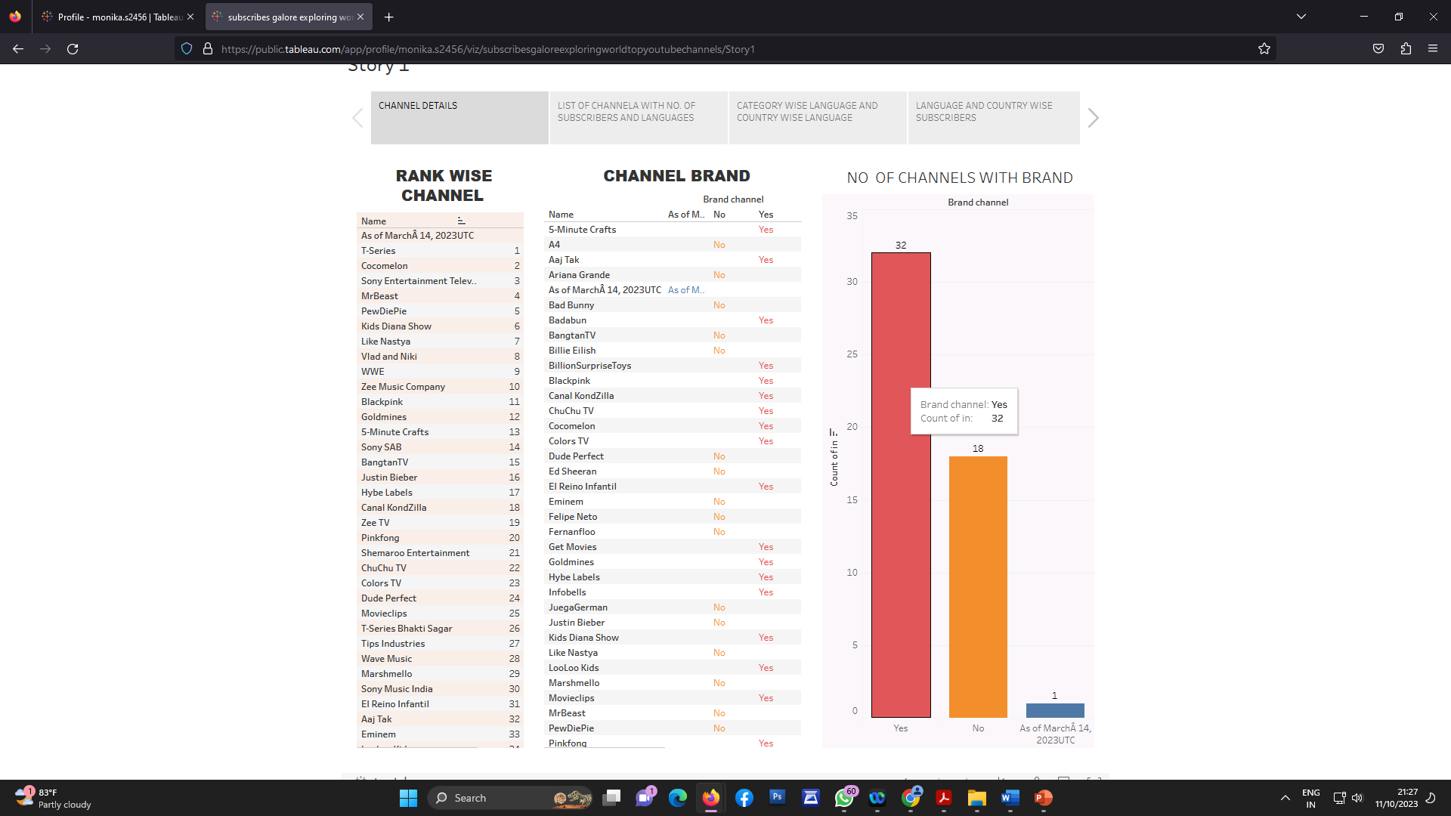
Activity 1.1 : Rank wish Channel, No of Channels with Brand And Channel Brand Explanation video link:

Slide 4
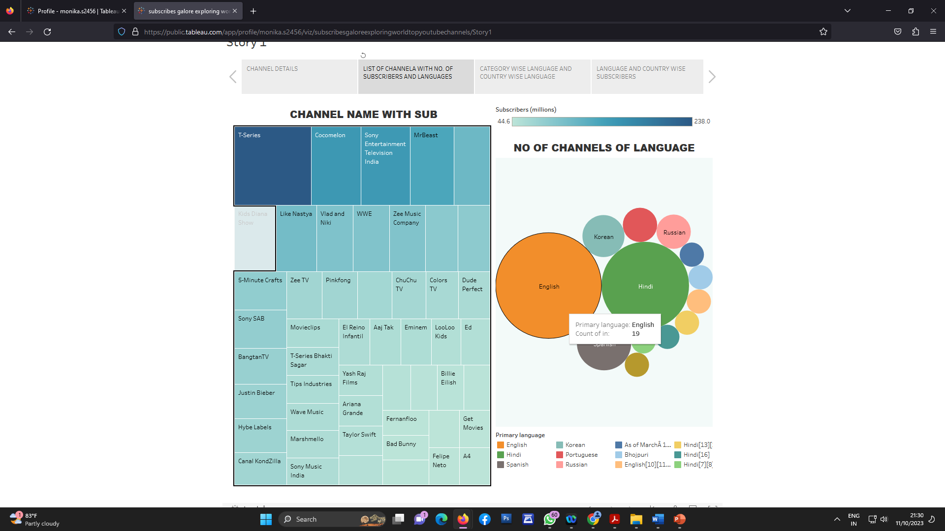
Activity 1.2 :Channel name with subscribers and No of channels for particular language.

Slide 5
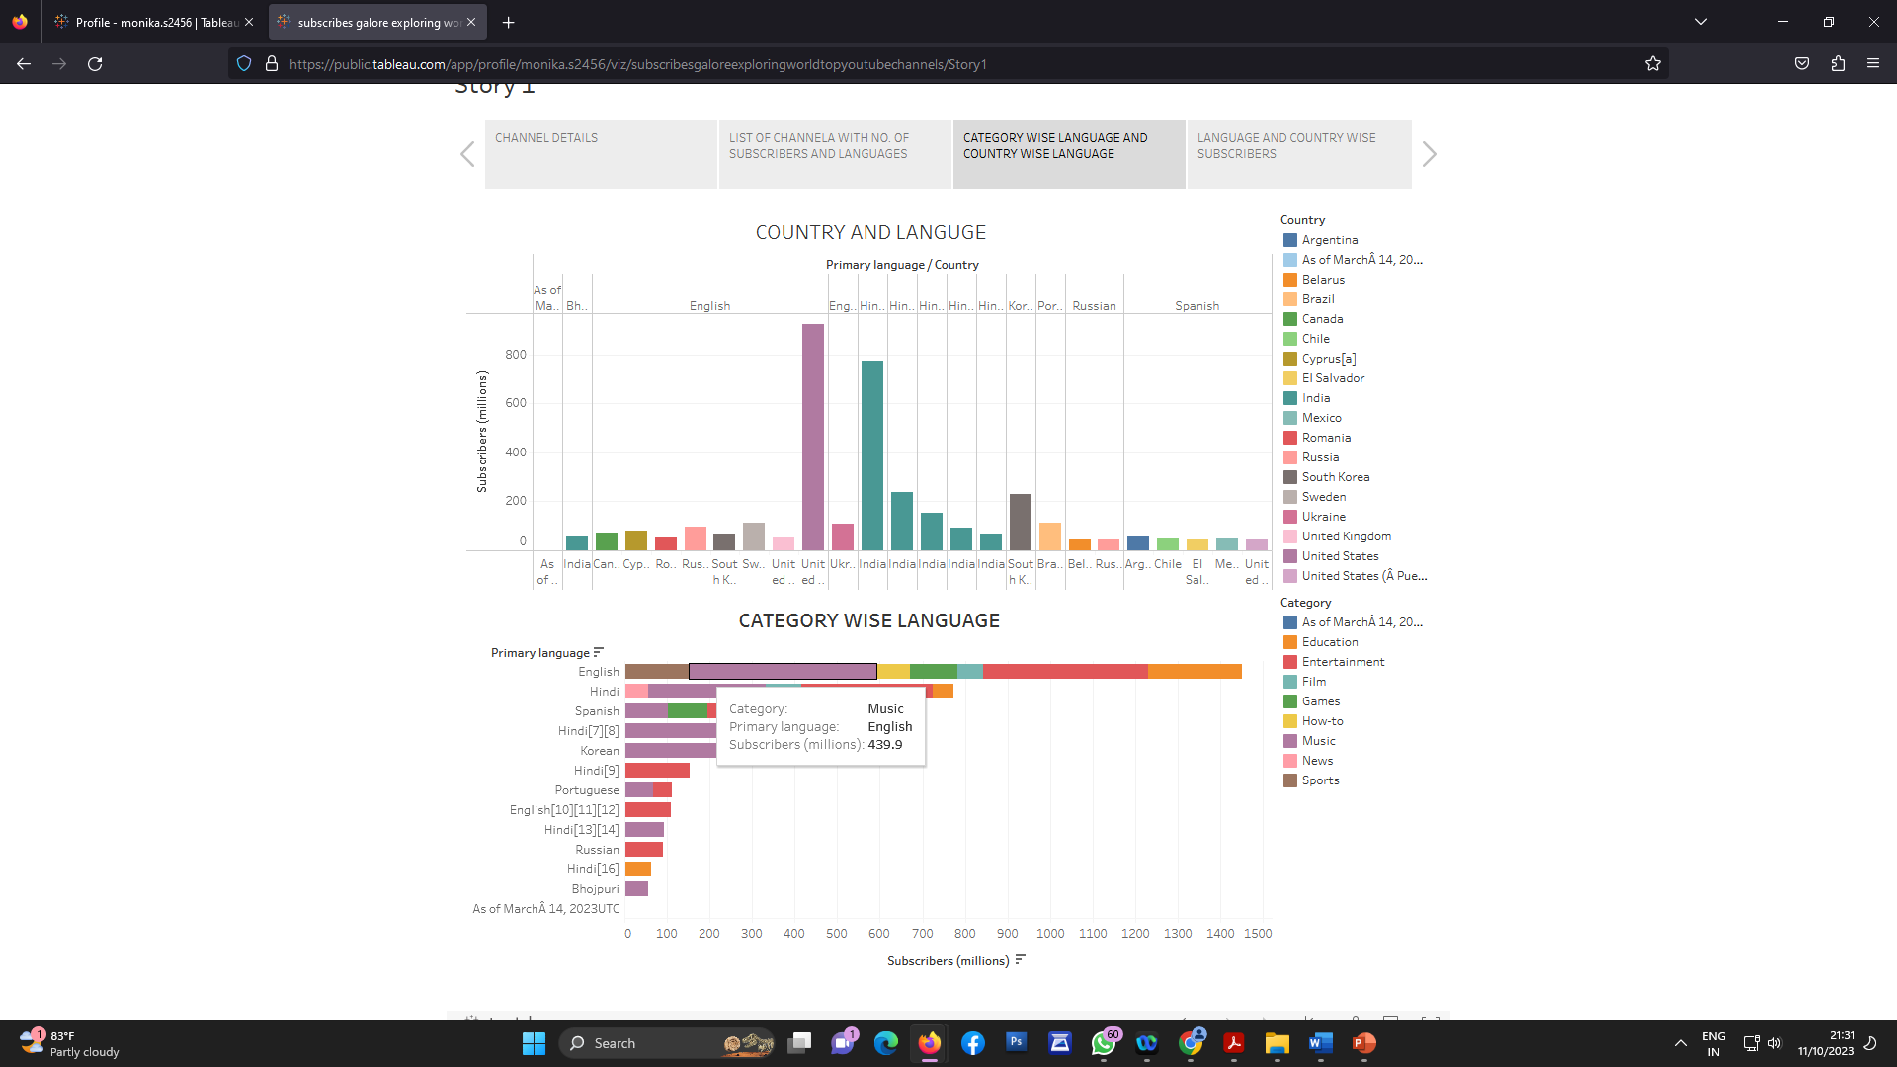
Activity 1.3 : Country and Language wise subscribers

Slide 6
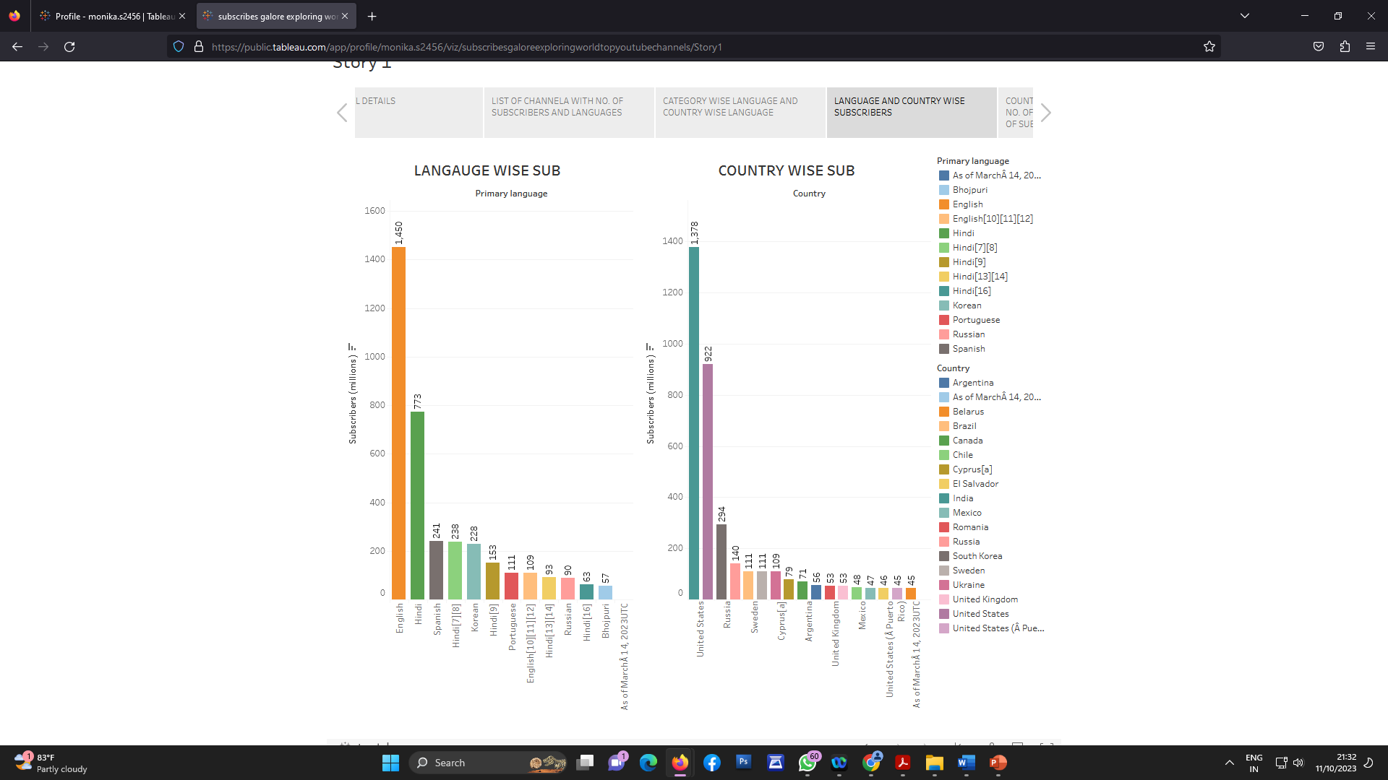
Activity 1.4 :Country wish subscribers and language wise subscribers..

Slide 7
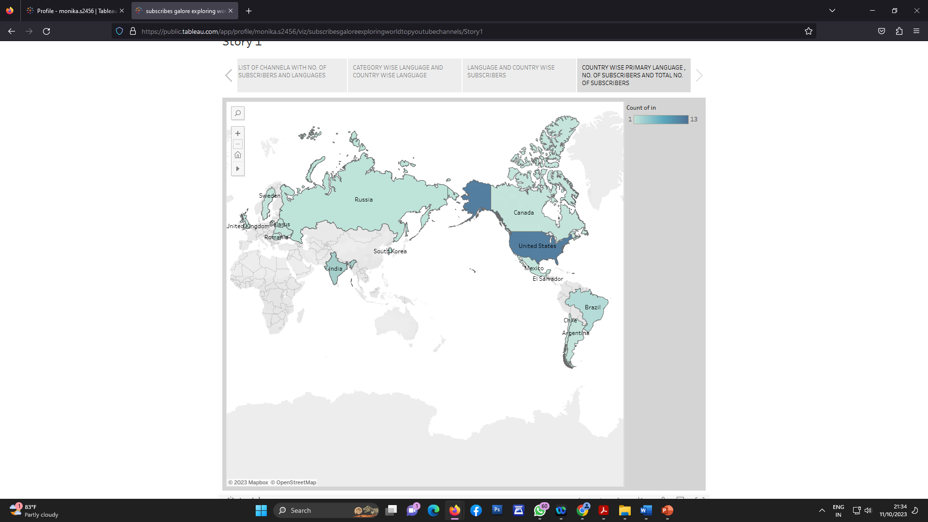
Activity 1.5 : country wise language..

Slide 8
THANK YOU

